Slide 1
Bed Occupancy Alarm clock
Getting you out of bed since 2020
(kicked you in the behind and left you on the curb wearing pajamas)
Dana Deutsch

Slide 2

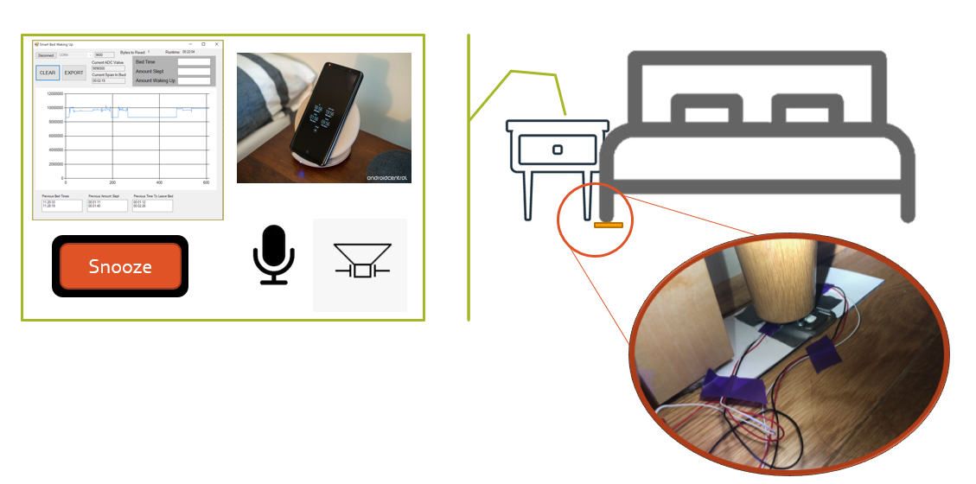
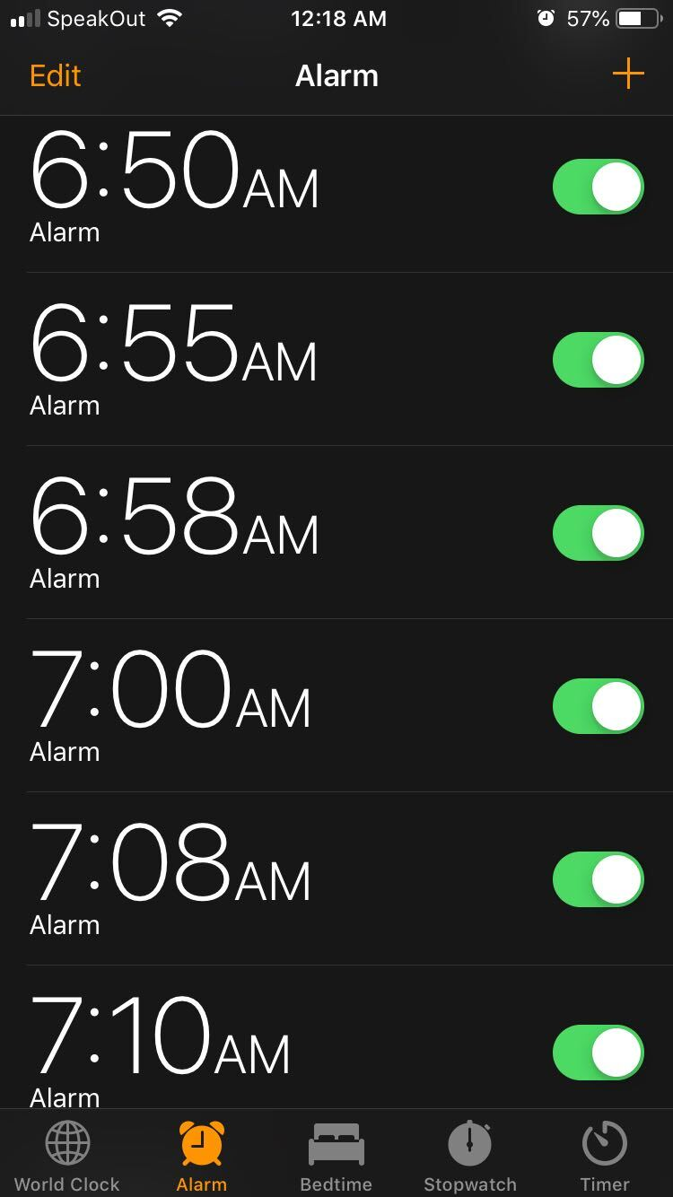
If you fall back to sleep after turning off your alarm, or don’t have the motivation to leave the bed, this product is for you

Slide 3
The alarm that knows if you left the bed
Senses when your phone alarm goes off
Short snooze which cant be completely turned off until you leave the bed
Keeps checking bed status until an hour after you get out of bed before stopping the cycle

Slide 4
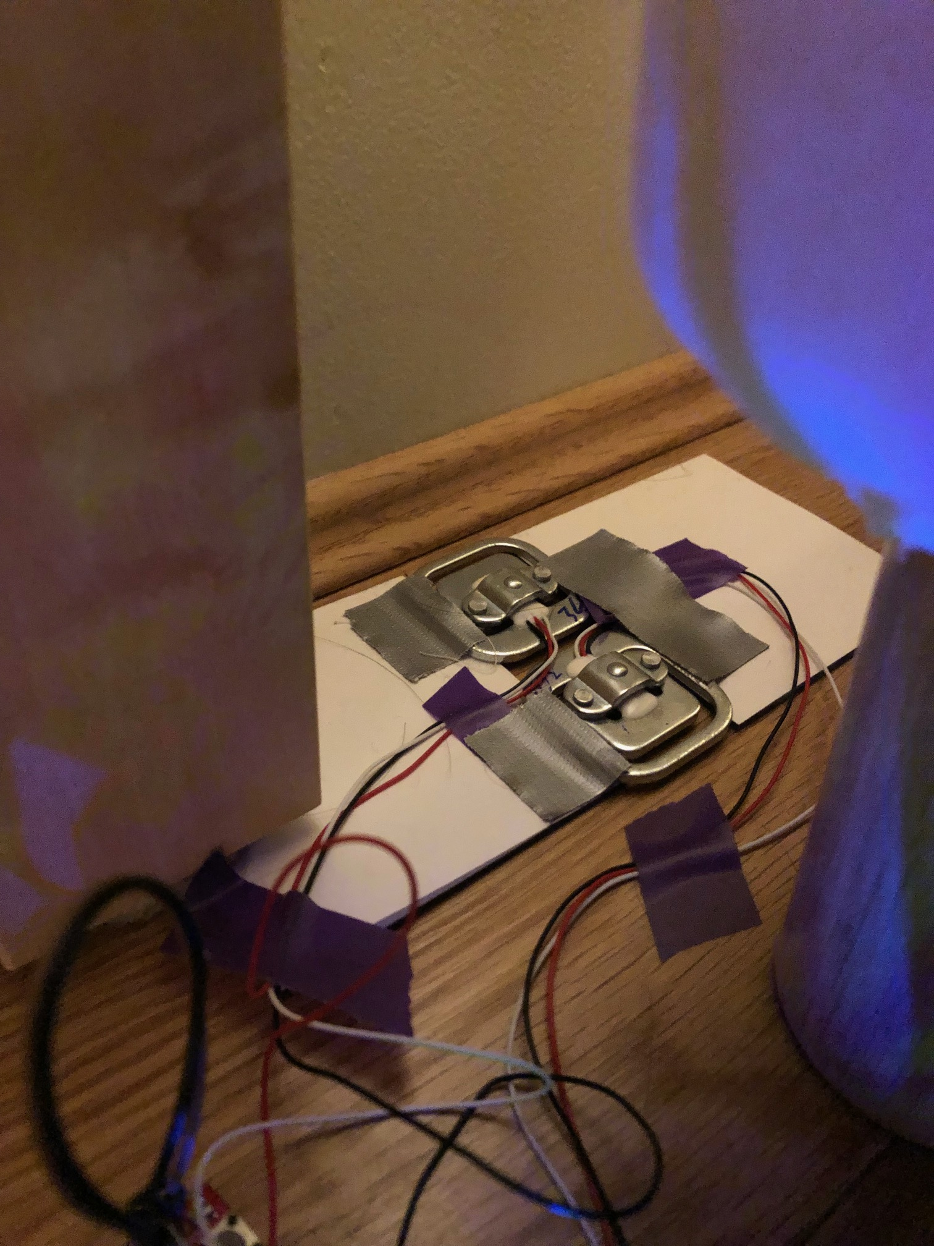
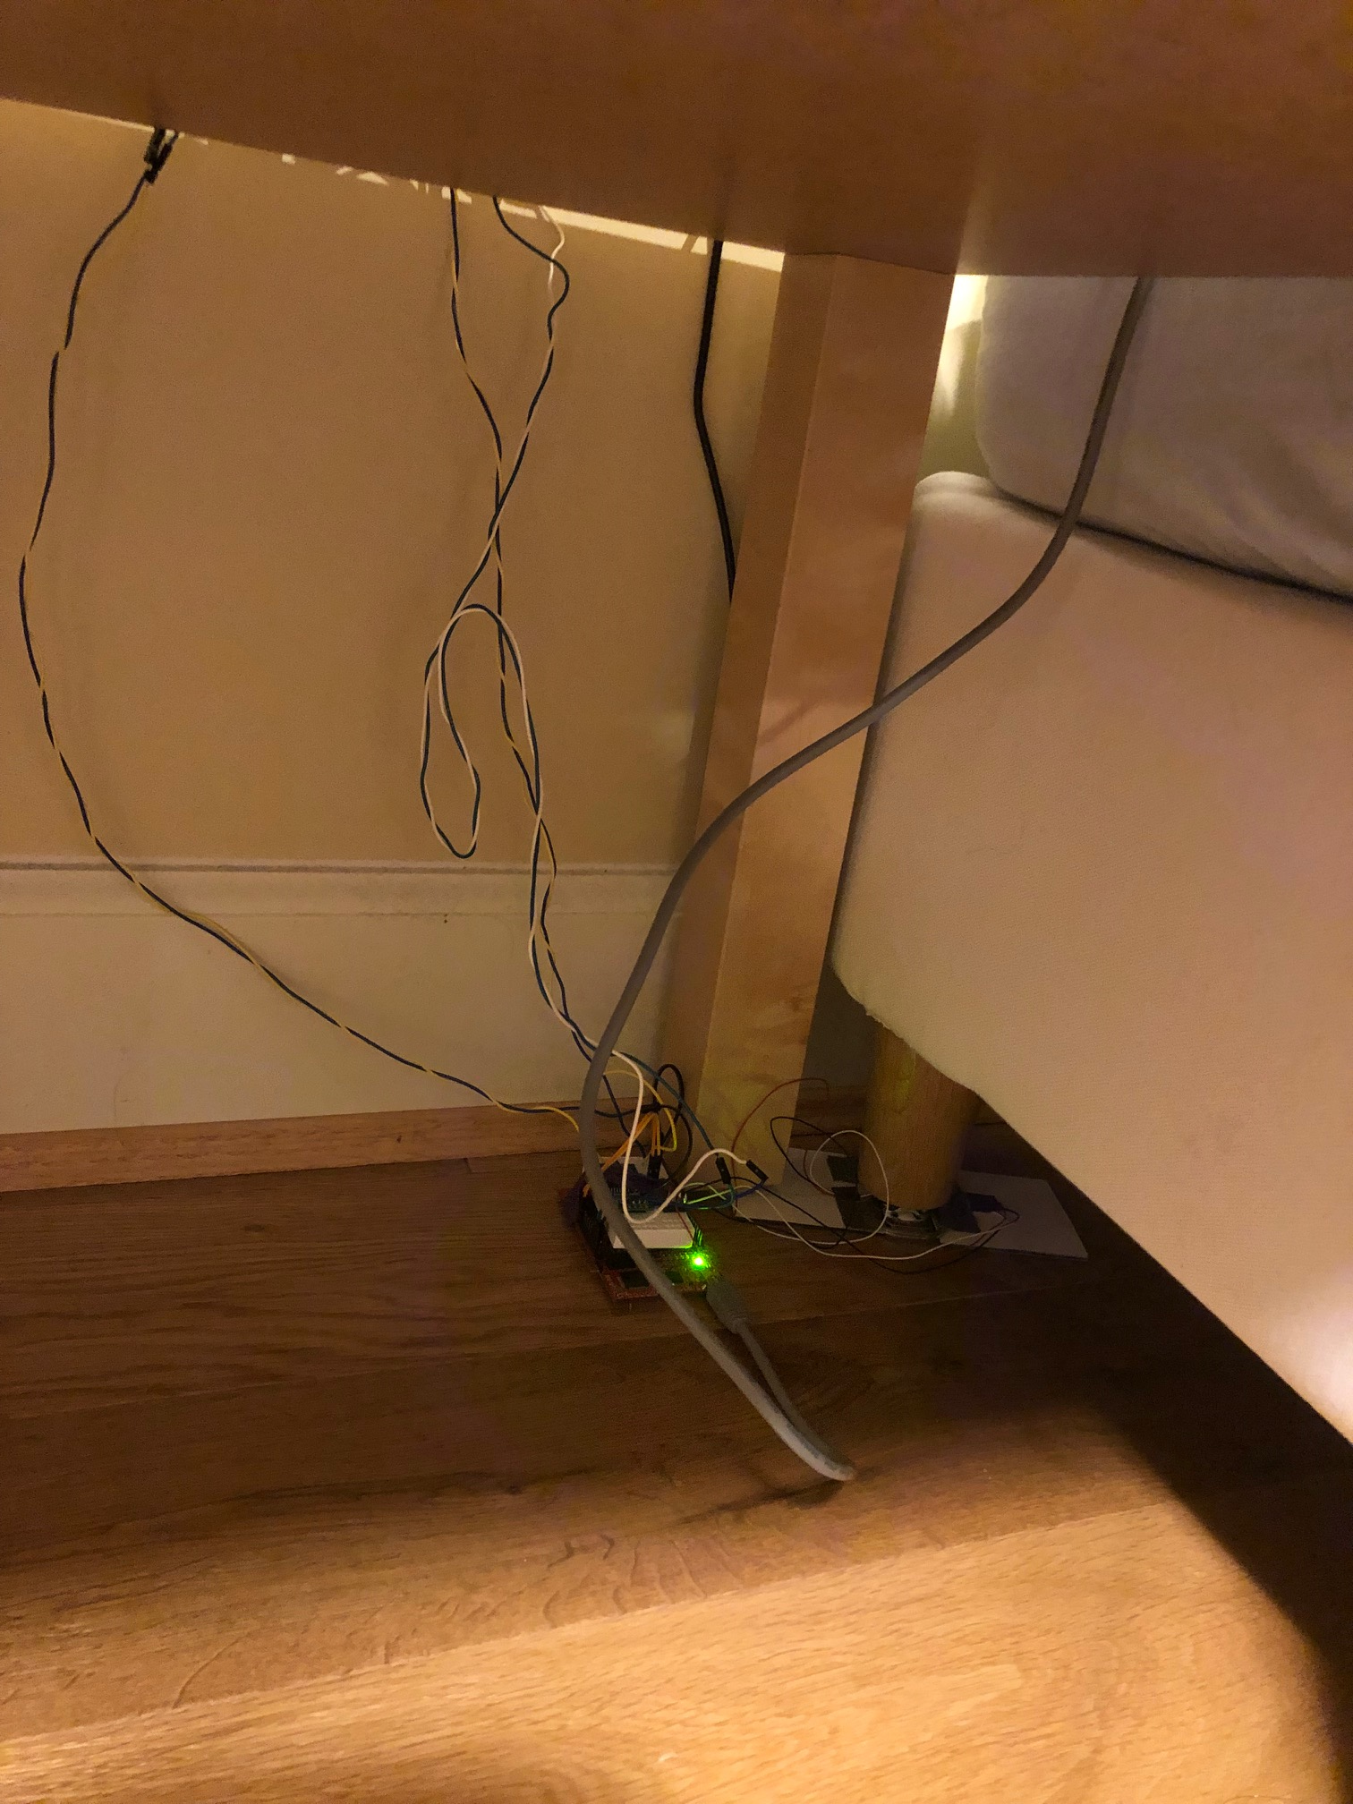
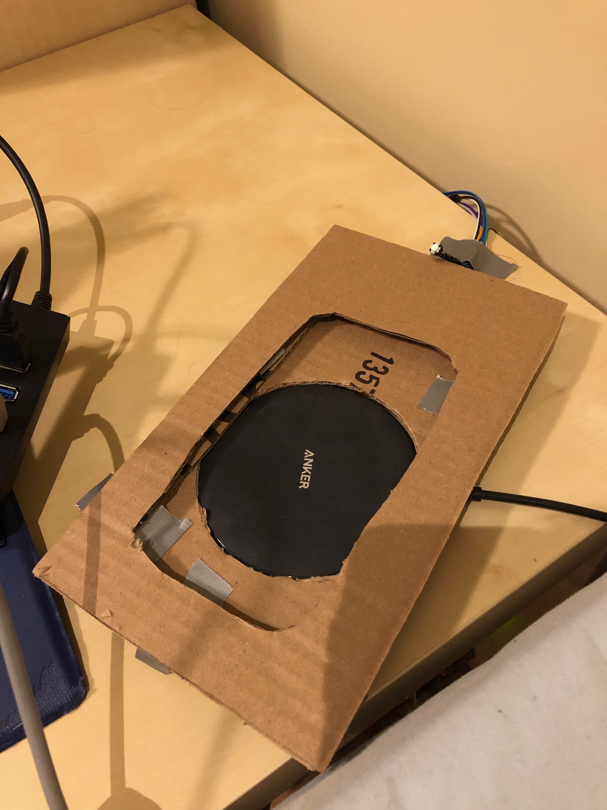
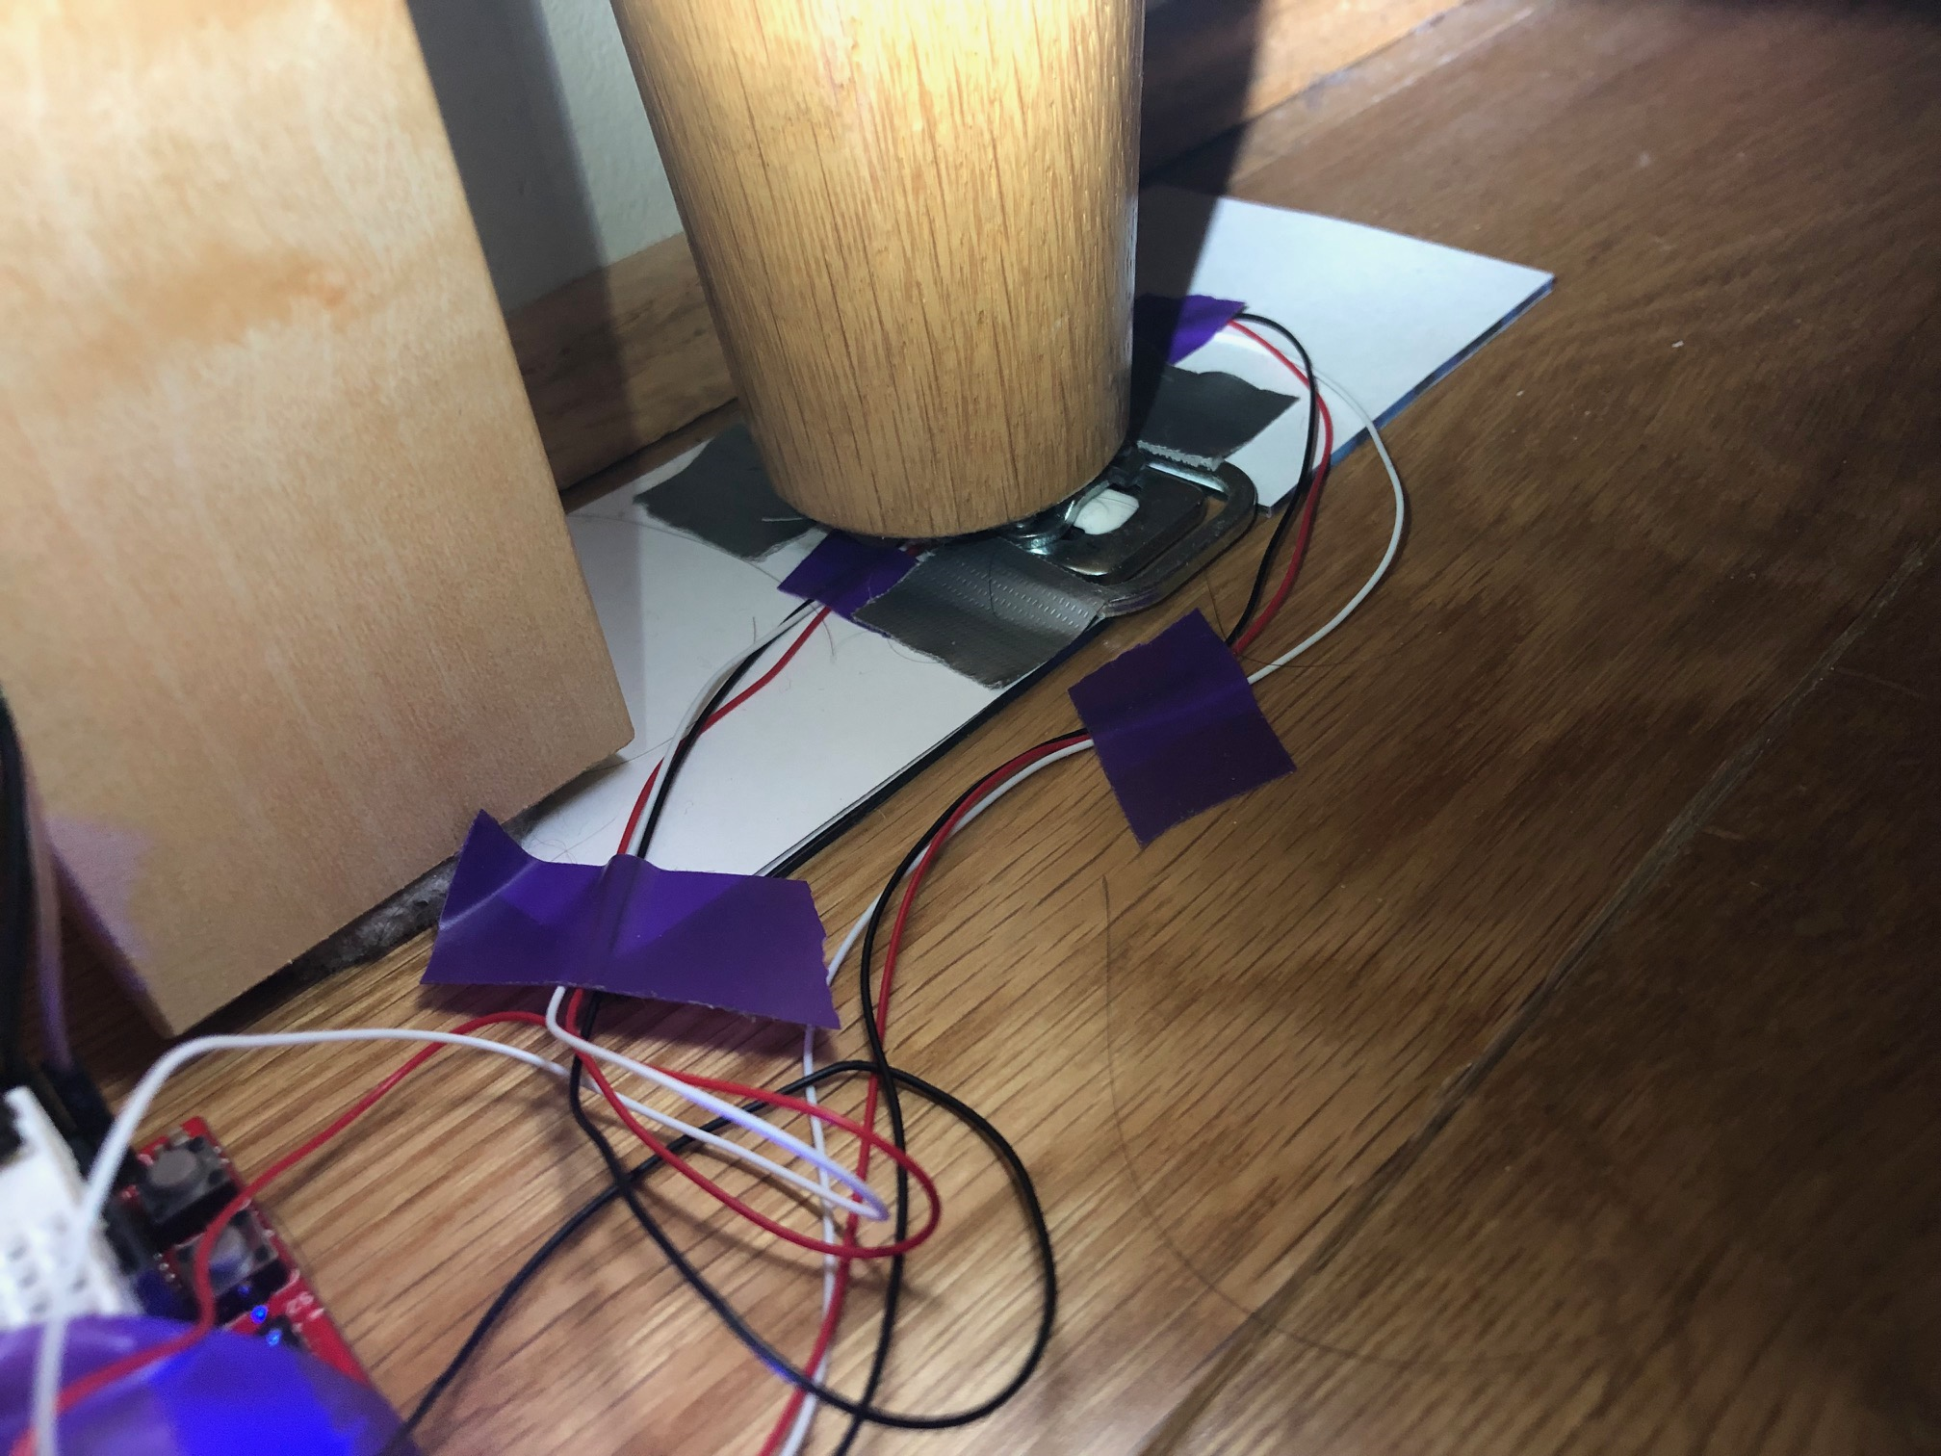
Components –Sensors and Actuators
Buzzer and Microphone sensor Under here
Push Button
Two 50kg Half Bridges Load Sensors
MSP430 and HX711 Amplifier and ADC Board

Slide 5
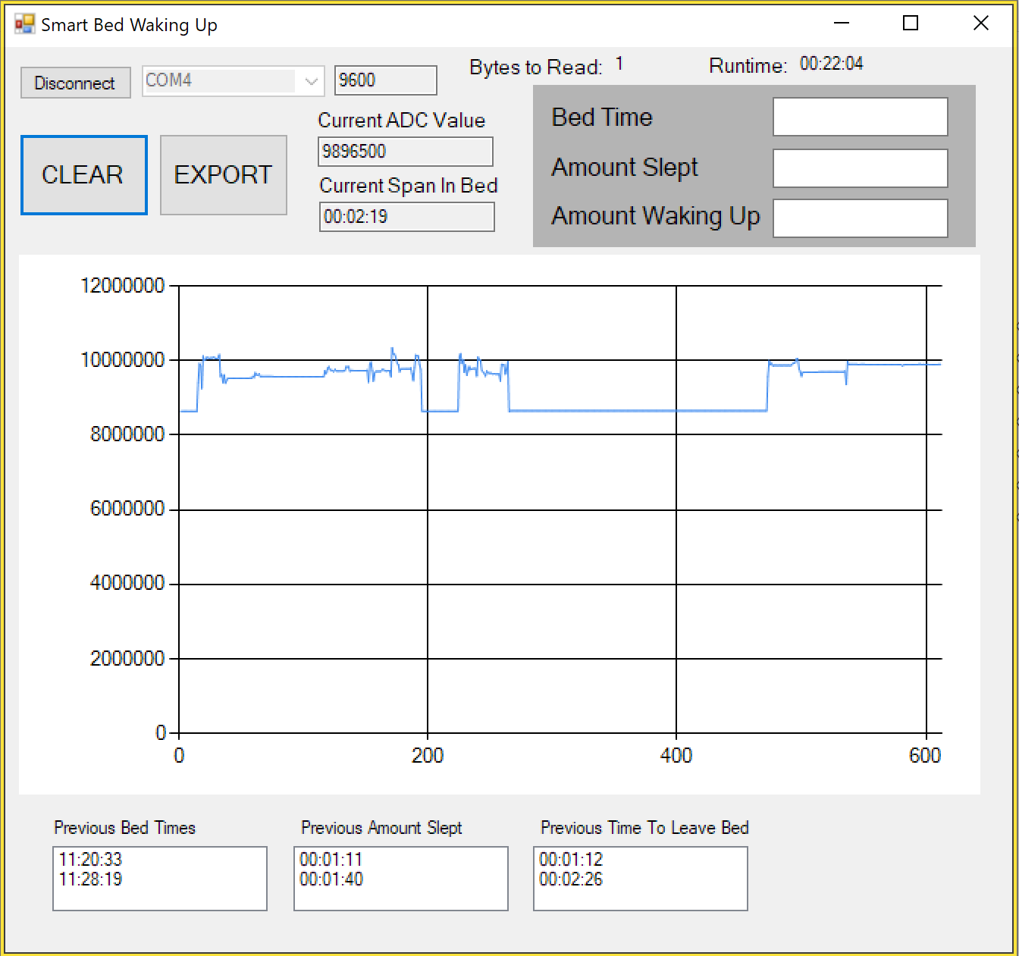
Components - Display
Connection Info
For Graph
Current Cycle Info
1. Real Time Entered Bed of Bed Entry Before Alarm
2. Amount of Time Slept Before Alarm
Real time ADC Value Plot
3. How Long It took to Get Up and Stay Up
Previous Sleep Cycle Info

Slide 6
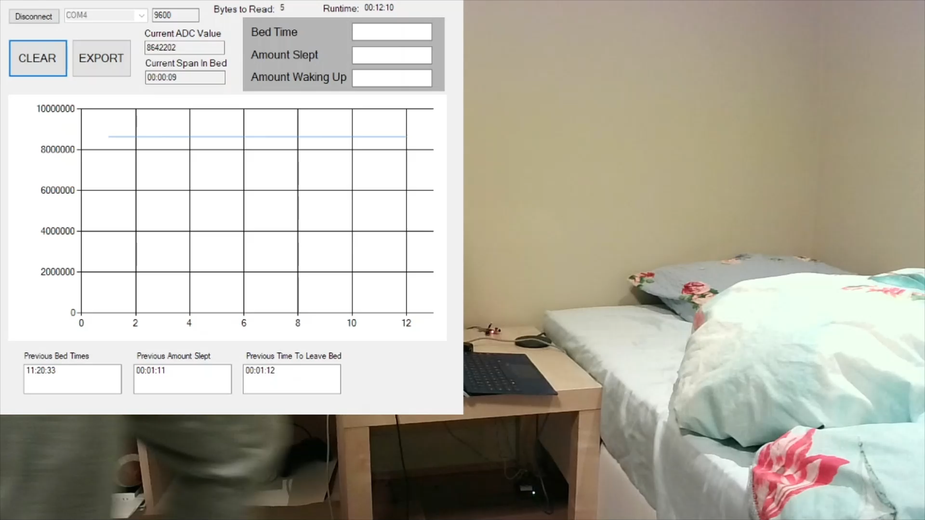

Slide 7
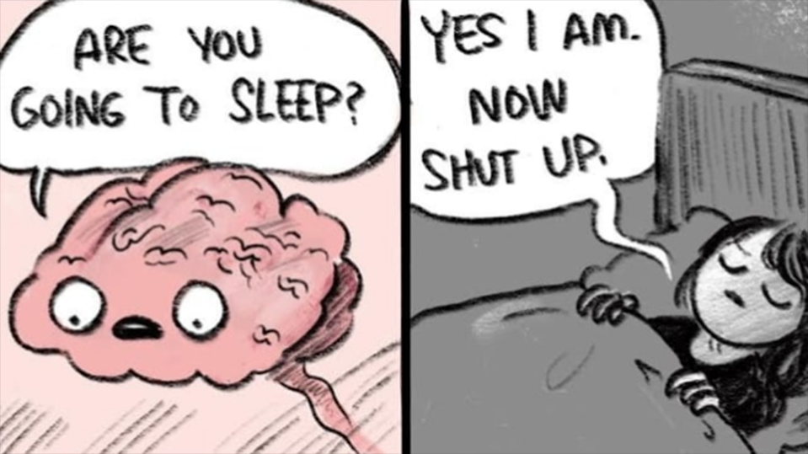

Thank You For Watching

Slide 8
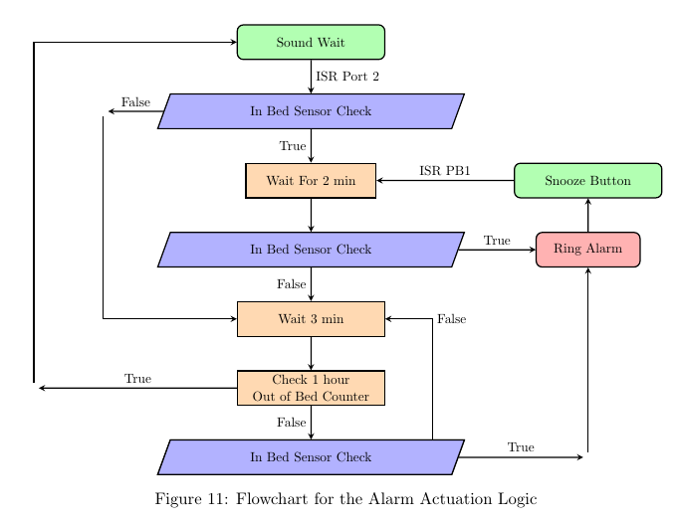
Flow diagram

Slide 9
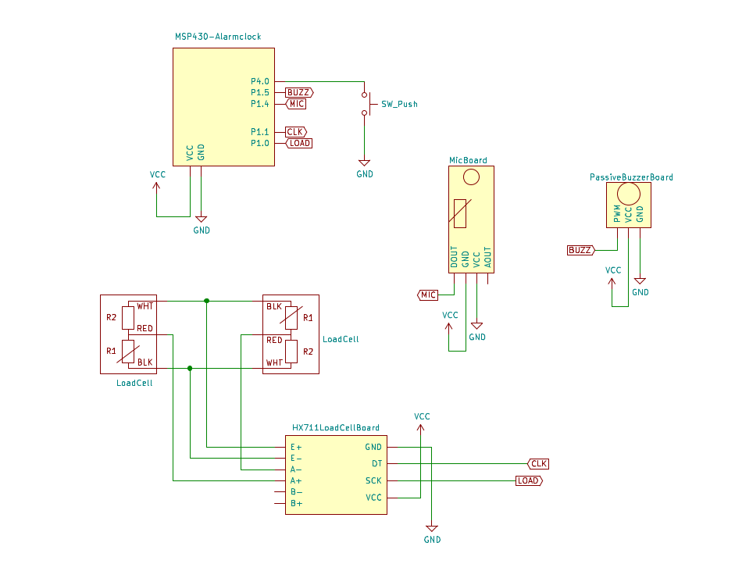
System Components Summery
MSP430
Half Bridge Load Sensors
Amplifier and ADC for Wheatstone Bridge circuit strain gauge signal conditioning
Push Button
Piezo Buzzer
Microphone Sensor
Optional: C# Information Display on laptop

Slide 10
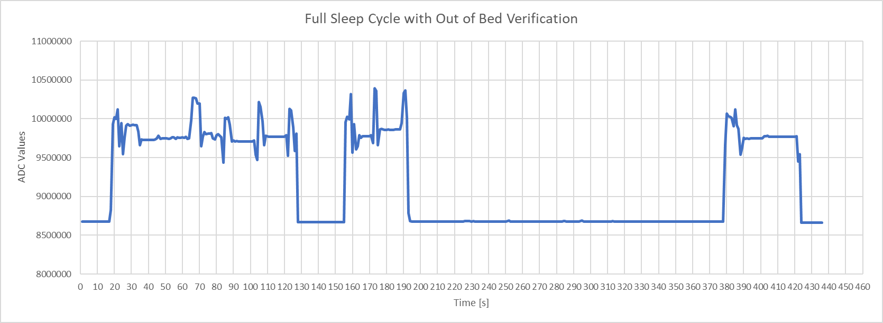
Shortened Example Cycle
We see spikes because I lean on the corner/edge of the bed where the sensor is located when reaching to turn off the alarms
Enter Bed
Phone Alarm
47
Amount Slept
Enter bed and go to sleep – Woken Up by phone alarm – Turn off but stay in Bed

Slide 11
Shortened Example Cycle
We see spikes because I lean on the corner/edge of the bed where the sensor is located when reaching to turn off the alarms
Buzzers
Buzzers
Buzzers
Exit Bed
15
15
15
60
Amount To Wake up
Snooze rings every 15 seconds after turning off the phone alarm until we leave the bed

Slide 12
Shortened Example Cycle
We see spikes because I lean on the corner/edge of the bed where the sensor is located when reaching to turn off the alarms
Buzzers
15
15
29
124
New Time To Wake up
Returning under 2 min will keep reinitializing the snooze cycles

Slide 13
Shortened Example Cycle
We see spikes because I lean on the corner/edge of the bed where the sensor is located when reaching to turn off the alarms
In bed with no Buzzer
188
44
After 2min system cycle ends bed can be entered safely

Slide 14

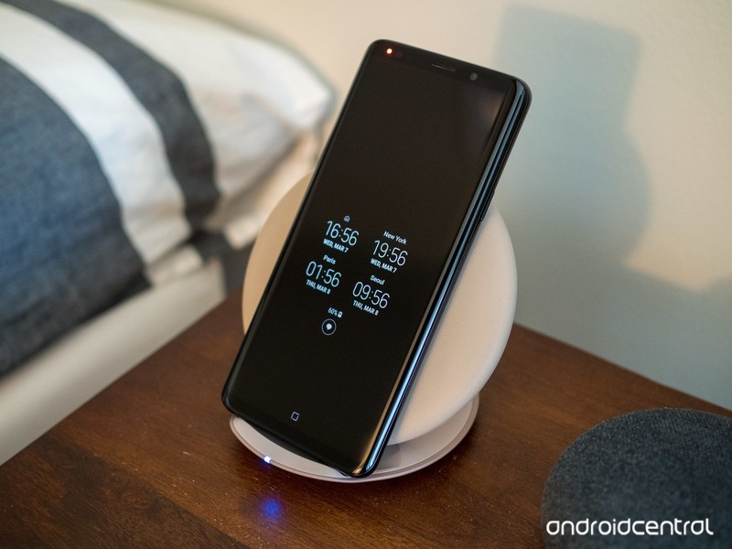
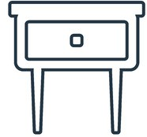


Bed Occupancy Alarm Clock System
Snooze

